Slide 1
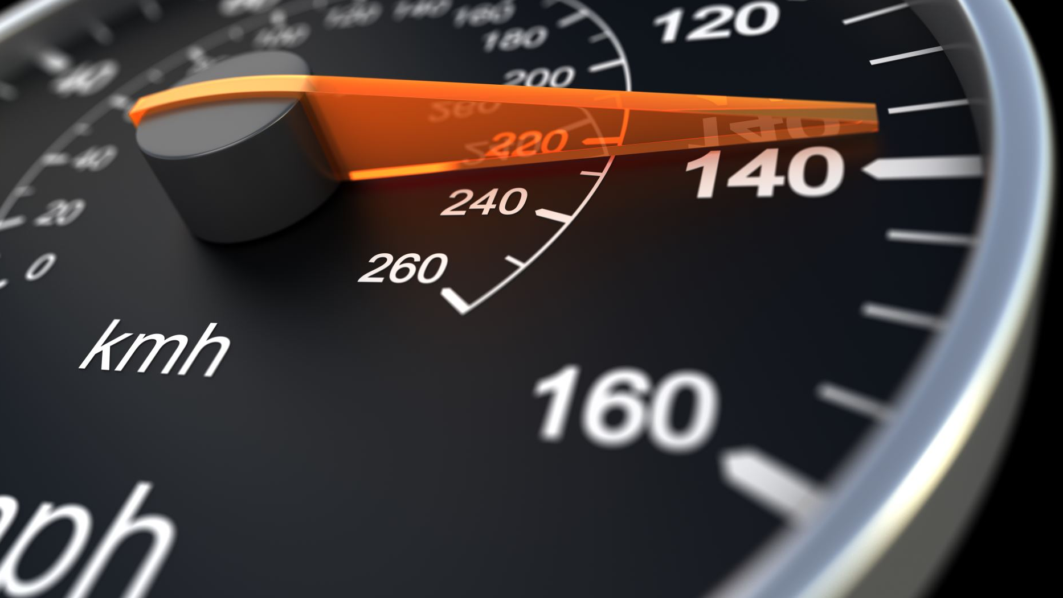
The limitations of a continuous wave Doppler radar for vehicle speed measurement and enforcement
Ruben van Tonder
Supervisor: Dr. W. Steyn

Slide 2
Reasons for project
The most common method of speed measurement and enforcement is through use of a Doppler radar
Evidently the use of a Doppler radar is doubted and known to have limitations
The project aims to formulize and test the limitations of a Doppler radar in vehicle speed measurements and to determine whether the operation law is sufficient in mitigating the identified limitations
Operation Law:
No metal road signs or vertical flat surfaces larger than 1 meter in vertical height within 15° on either side of the aiming direction, within 30 m of the antenna.
No signals received and processed from vehicles more than 80 meters away
No other moving vehicle other than the measured vehicle within 90 meters from the radar in the direction of operation
The vehicle’s speed should be tracked for 0.5s for a valid reading to be possible

Slide 3
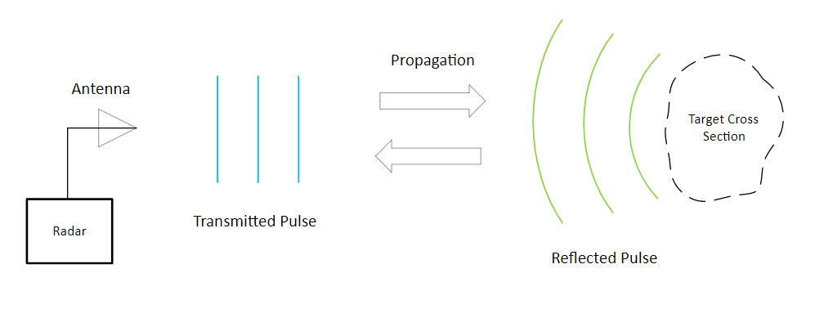
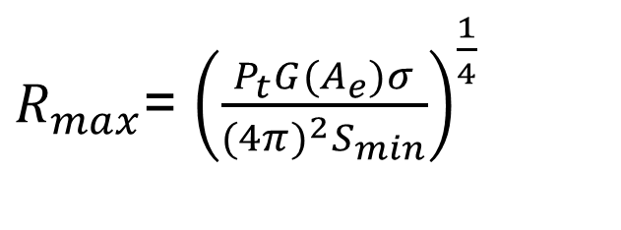

A Basic Radar
$P_{t}$ = Transmit Power
G = Antenna Gain
$A_{e}$ = Portion of Reflected Echo captured
$σ$ = Radar Cross Section(RCS)
$S_{min}$ = Minimum detectable Signal
$R_{max}$= ${\left(\frac{P_{t}G(A_{e})σ}{{(4π)}^{2}S_{min}}\right)}^{\frac{1}{4}}$

Slide 4
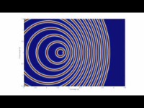
Doppler effect
https://www.youtube.com/watch?v=ZRGg7e9b5wY

Slide 5
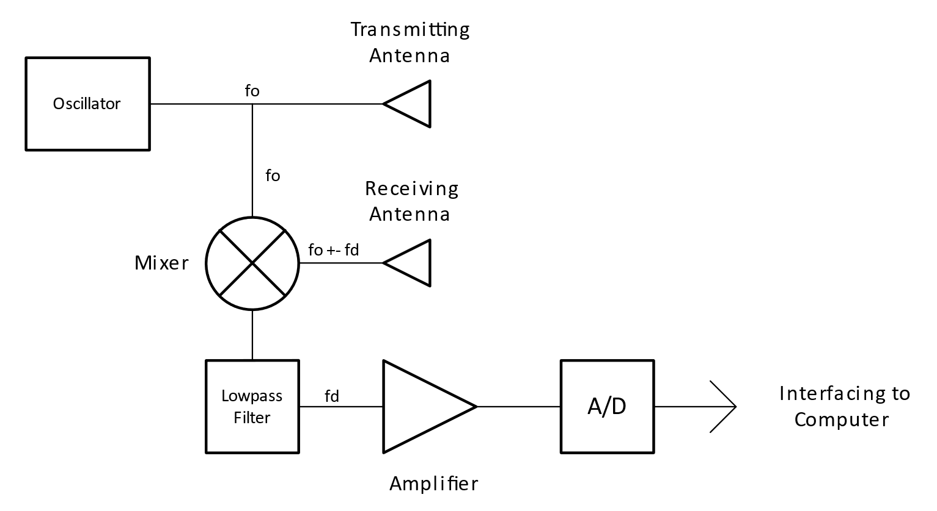
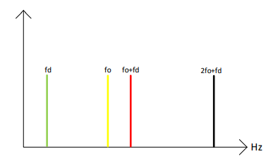


CW Doppler Radar
$$fd= \frac{2vfₒ}{c}$$
X – band radar: 1km\h = 19.49 Hz frequency shift
Frequency Resolution is the ability of a radar to distinguish between two objects travelling at different speeds but at the same distance from the radar
Range Resolution is the ability of a radar to distinguish between two or more targets on the same bearing, but at different ranges
$R_{max}$= (${\frac{P_{t}G(A_{e})σ}{{(4π)}^{2}S_{min}})}^{\frac{1}{4}}$

Slide 6
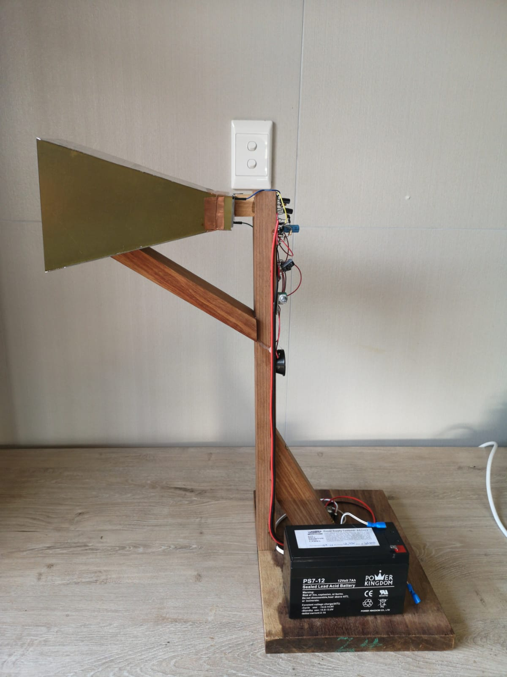
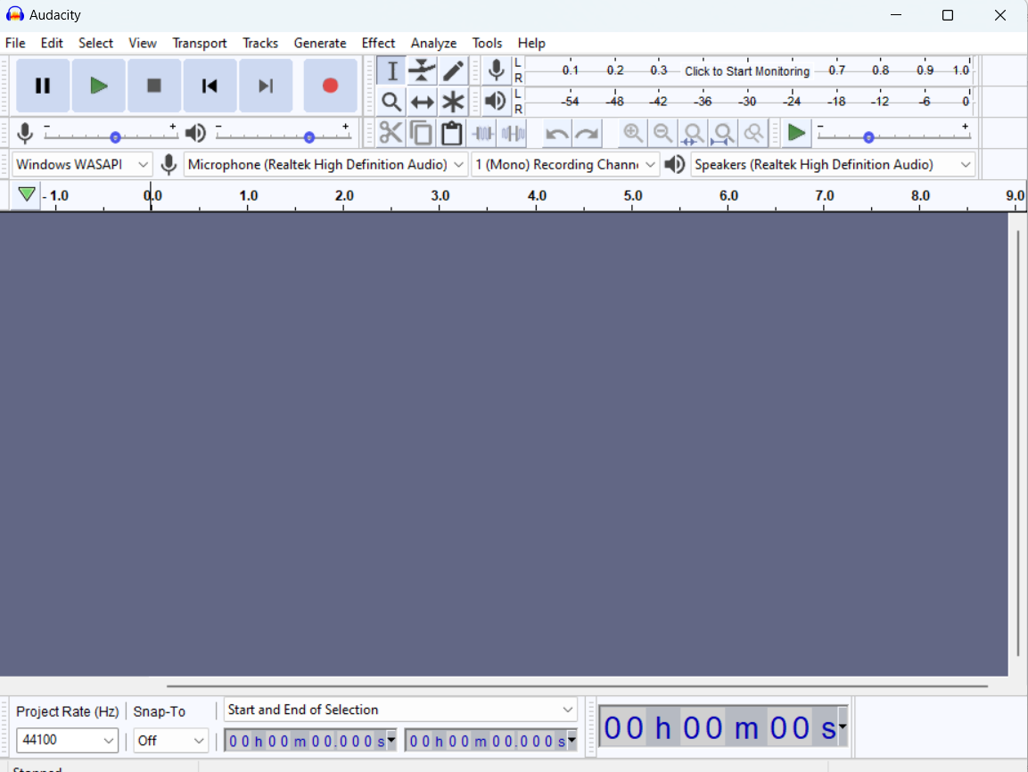
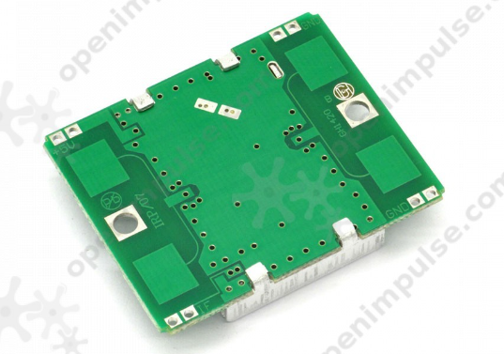
Designed CW Doppler Radar

Slide 7
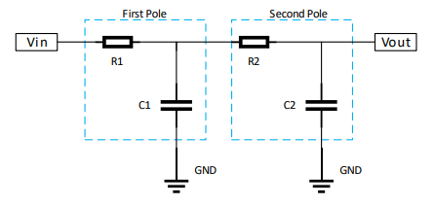
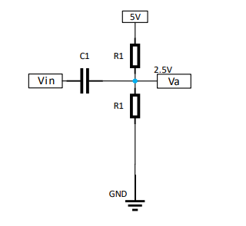
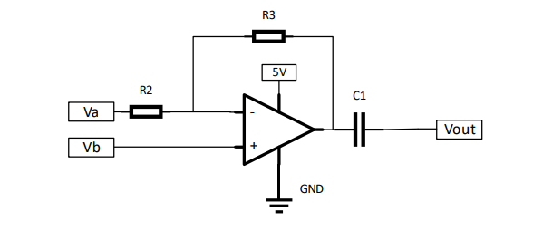
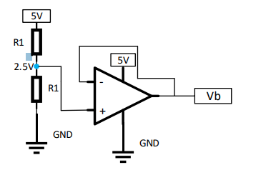
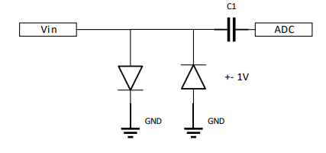
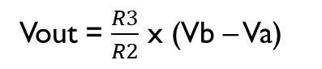
Lowpass filter, Amplifier & clipper
Filter
Amplifier
Vout = $\frac{R3}{R2}$ x (Vb – Va)
Clipper

Slide 8
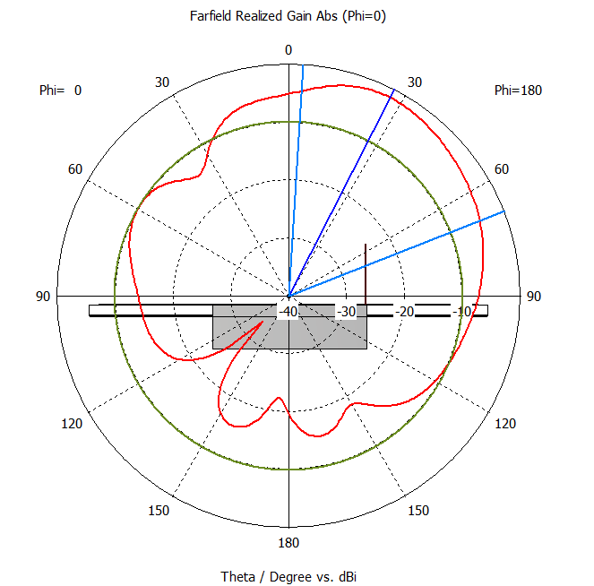

Hb100 sensor & Waveguide
The HB100 sensor contains an oscillator, mixer, transmit antenna and receive antenna
A waveguide was designed for each patch to feed into the horn antenna
Each waveguide was designed to only allow TE₁₀ modes, fc₁₀ = $\frac{c}{2a}$ , a > b
The HB100 sensor will fits inside the back of the waveguide

Slide 9
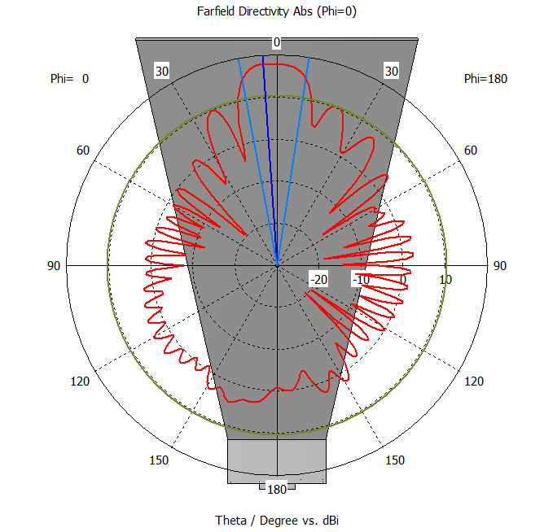
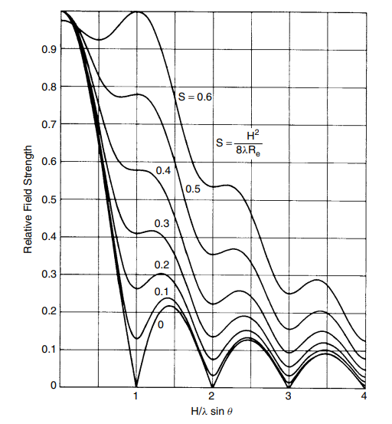
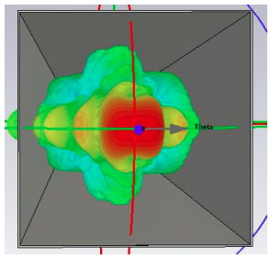

Horn antenna
The horn antenna was design using the equation:
$S= \frac{a^{2}}{2\text{l}R}$

Slide 10
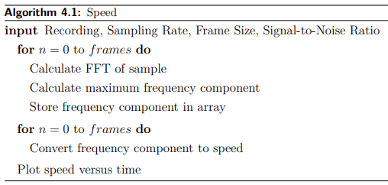
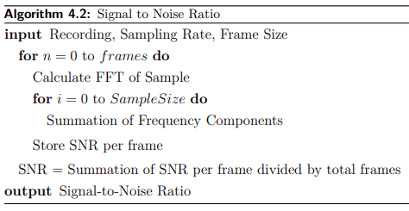
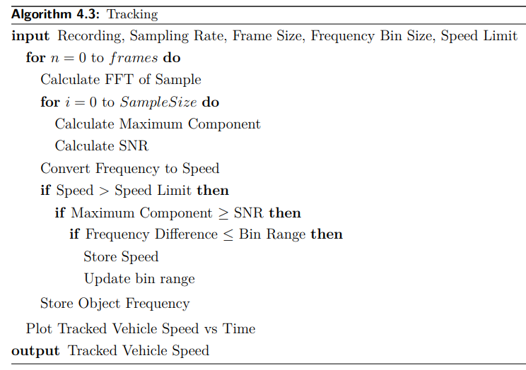
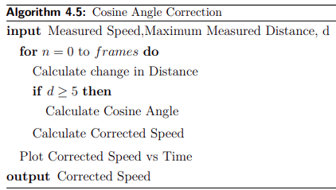
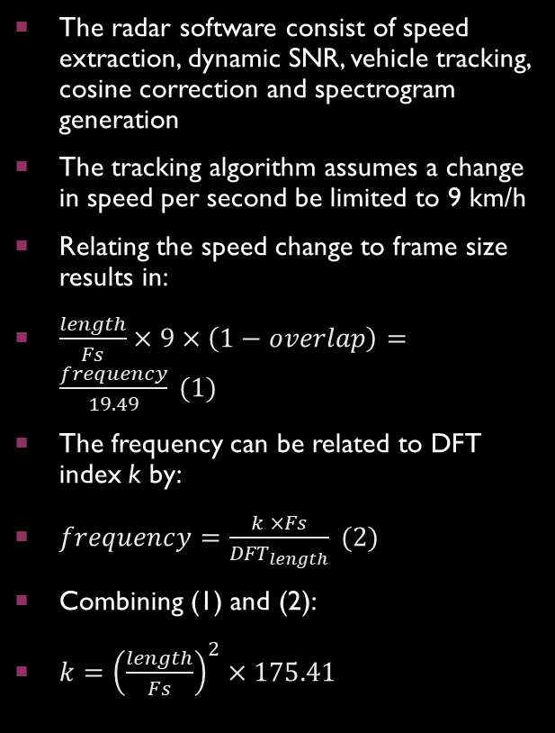
Radar Software
The radar software consist of speed extraction, dynamic SNR, vehicle tracking, cosine correction and spectrogram generation
The tracking algorithm assumes a change in speed per second be limited to 9 km/h
Relating the speed change to frame size results in:
$\frac{length}{Fs}×9×\left(1−overlap\right)=\frac{frequency}{19.49} (1)$
The frequency can be related to DFT index k by:
$frequency=\frac{k ×Fs}{{DFT}_{length}} (2)$
Combining (1) and (2):
$k={\left(\frac{length}{Fs}\right)}^{2}×175.41$

Slide 11
Radar software: Speed

Slide 12
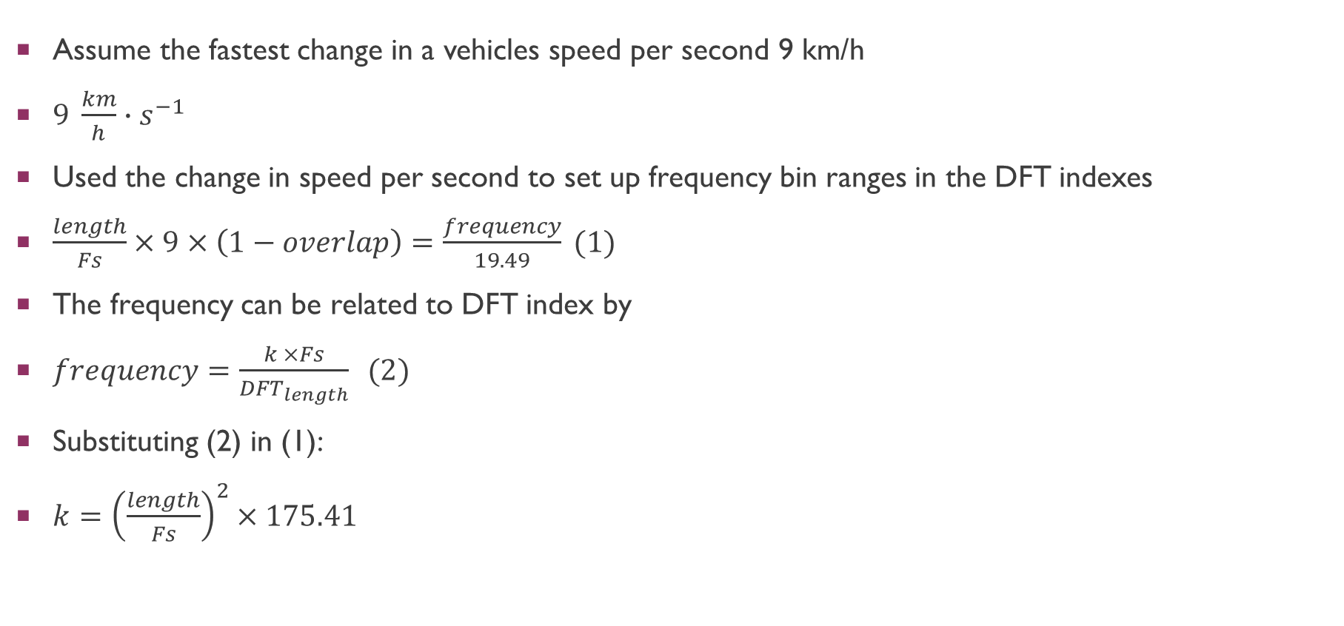
Radar software: Tracking
Assume the fastest change in a vehicles speed per second 9 km/h
$9 \frac{km}{h}∙s^{−1}$
Used the change in speed per second to set up frequency bin ranges in the DFT indexes
$\frac{length}{Fs}×9×\left(1−overlap\right)=\frac{frequency}{19.49} (1)$
The frequency can be related to DFT index by
$frequency=\frac{k ×Fs}{{DFT}_{length}} (2)$
Substituting (2) in (1):
$k={\left(\frac{length}{Fs}\right)}^{2}×175.41$

Slide 13
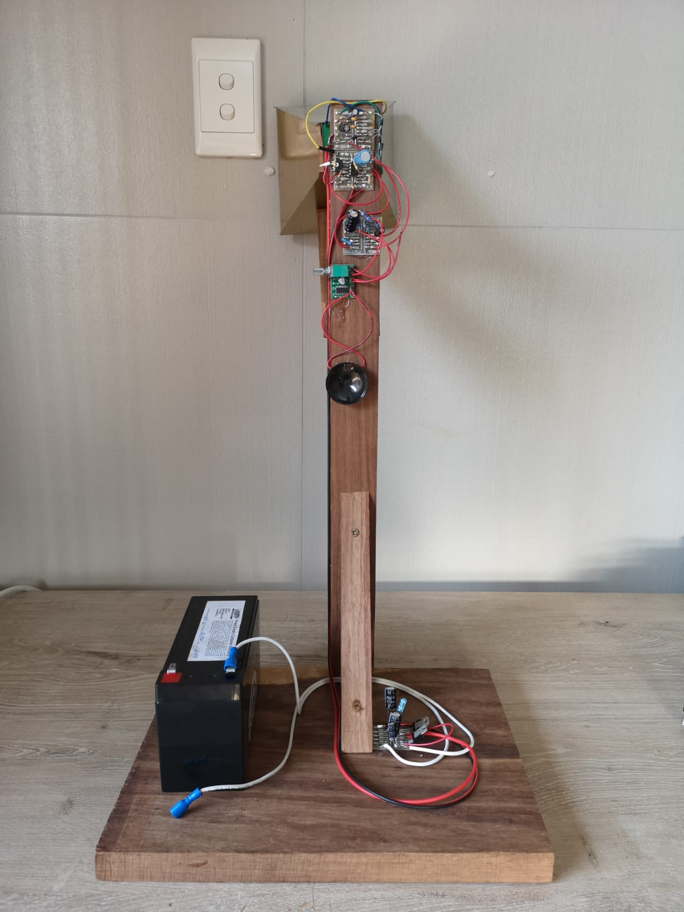
CW Doppler Radar & setup
The front side of the radar houses the horn antenna and HB100 Sensor
The back side is where the lowpass filter, amplifier and clipper circuit is located
The power supply and battery is mounted on the bottom
The setup is used in the testing of the radar

Slide 14
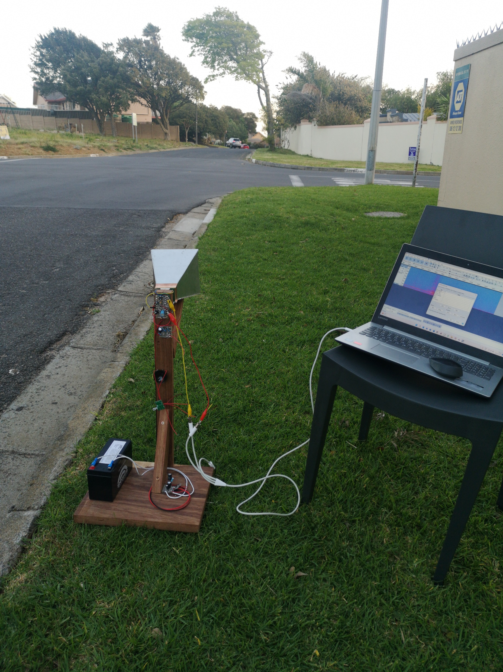

Radar setup

Slide 15
Radar results
Vehicle is measured from 85m away from radar

Slide 16
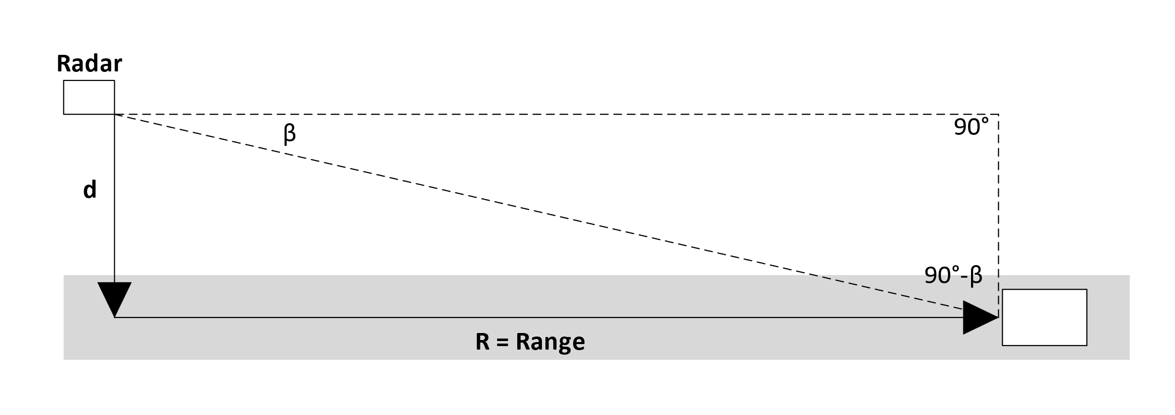


Cosine Effect
$β= \tan^{−1}\left(\frac{d}{R}\right)$
$V_{m}= V_{o}\cos{β}= V_{o}\frac{R}{{\left(R^{2}+d^{2}\right)}^{0.5}}$
For most of the measured speed the cosine effect is insignificant
The radar can only correct the cosine effect on one fixed length $d$

Slide 17
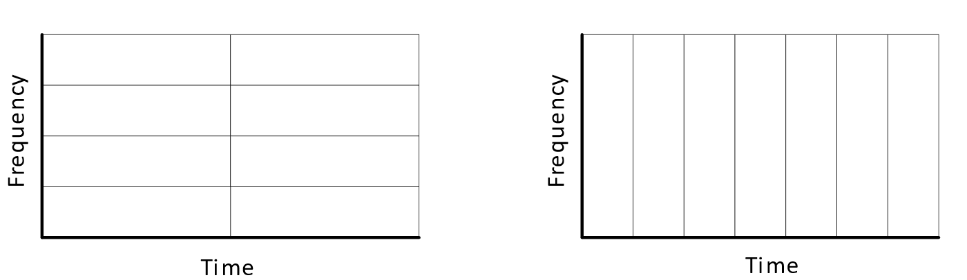
Accuracy and Acceleration Limits
Differentiation in TIME vs Differentiation in FREQUENCY
Increasing frame size increases frequency resolution
Decreasing frame size increases time resolution

Slide 18
accuracy and acceleration limits
The ideal resolution in time and frequency is shown on the top, with a frame size = 0.122s and acceleration = 1.4 km/h
The middle measurement is focused on time resolution with a frame size = 0.029s and acceleration = 0.33 km/h
The bottom measurement is focused on frequency resolution with a frame size = 0.544s and acceleration = 3.5 km/h

Slide 19
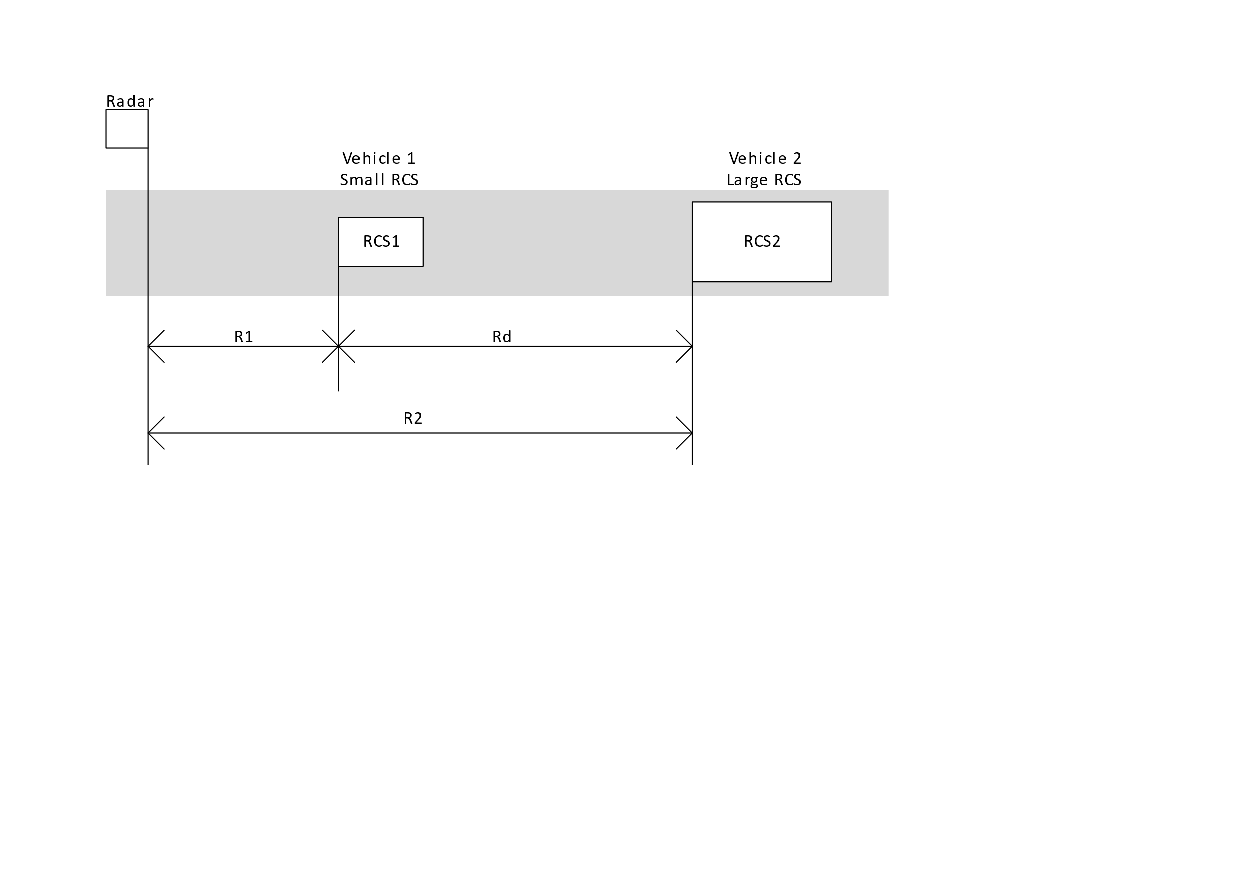


Object identification
CW Doppler radar cannot determine how far a vehicle is from the radar
If two vehicles are in range the radar will not be able to determine which speed is related to which vehicle
$$R_{1}=R_{2}{\left(\frac{σ_{2}}{σ_{1}}\right)}^{\frac{1}{4}}$$
$$R_{d}=R_{1}\left[{\left(\frac{σ_{2}}{σ_{1}}\right)}^{\frac{1}{4}}−1\right]$$

Slide 20
object identification
The top spectrogram indicates a measurement of a vehicle where the vehicle is measured from around 60m away
The bottom spectrogram indicates a measurement of a vehicle in range of the radar for around 30m
This difference in ranges are due to difference in RCS of each vehicles with the vehicle measured from 60m having a 9.5 times the RCS size of the vehicle measured from 30m

Slide 21
object identification
The radar is incapable to attached a specific measurement to a specific vehicle
The spectrogram illustrates two vehicle crossing each other with similar speeds
The radar is not capable of tracking both vehicles

Slide 22
Antenna Sidelobes
The radiation pattern of the radar antenna mainly determines the angle at which a vehicle will be measured
The operator/installer should be aware of how the radiation pattern looks otherwise the radar might measure unintended vehicles
Degrees West of North | HB100 Sensor | Horn Antenna
0° | 62m | 85m
30° | 52m | 32m
60° | 30m | 21m

Slide 23
Multipath reflection
Signals are capable of reflecting against metal surfaces
This can mean a vehicle is measured from behind the radar if the signal reflects from a metal surface
The setup below was used to demonstrate a signal reflecting against a billboard and measuring the vehicle when it is still behind the radar

Slide 24
multipath reflection
The 4.1s timestamp on the spectrogram is when the vehicle passes the radar from behind
The spectrogram shows a faint line measured before the 4s timestamp
The speed graph supports this indicating a tracked vehicle is measured as early as 0.2s into the measurement
The vehicle is measured as far as 35m behind the radar

Slide 25
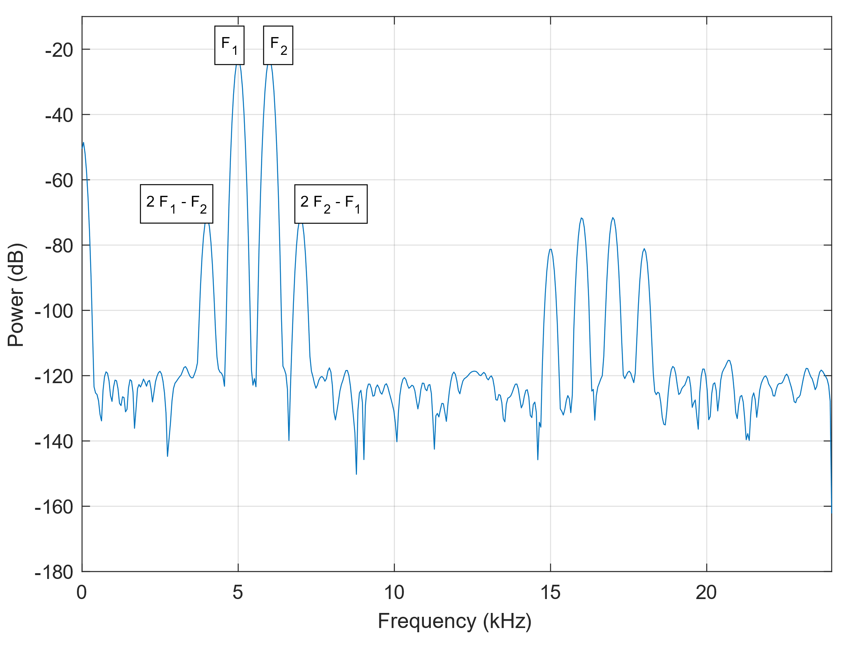
Receiver saturation
The receiver of the radar is prone to over saturate and cause harmonics, this is due to the mixer
The most prone harmonics is the 2nd and 3rd harmonics but in some cases more harmonics is present
The spectrogram indicates the result of 2nd and 3rd harmonics that are measured

Slide 26
receiver saturation
If the radar is placed alongside a two-lane road
A car passing behind the radar causes saturation and blinds the radar to any measurement
The spectrogram illustrates this, where a vehicle is measured until a vehicle passes behind the radar which blinds the radar for 0.5s
The radar then tracks the second vehicle where the originally tracked vehicle goes untracked

Slide 27
Results of Receiver Saturation

Slide 28
conclusion
The operation laws fail to take into account the following limitations:
The cosine error and the radar being limited to only one lane
The vastly varying size of RCS in vehicles
Radar Receiver Saturation
The effect of antenna sidelobes and how they impact a radars capability to measure a vehicles speed
The radars inability to associate signals with vehicles
Stricter operation laws are proposed or different methods of measuring a vehicles speed, like a FMCW Doppler radar

